Slide 1
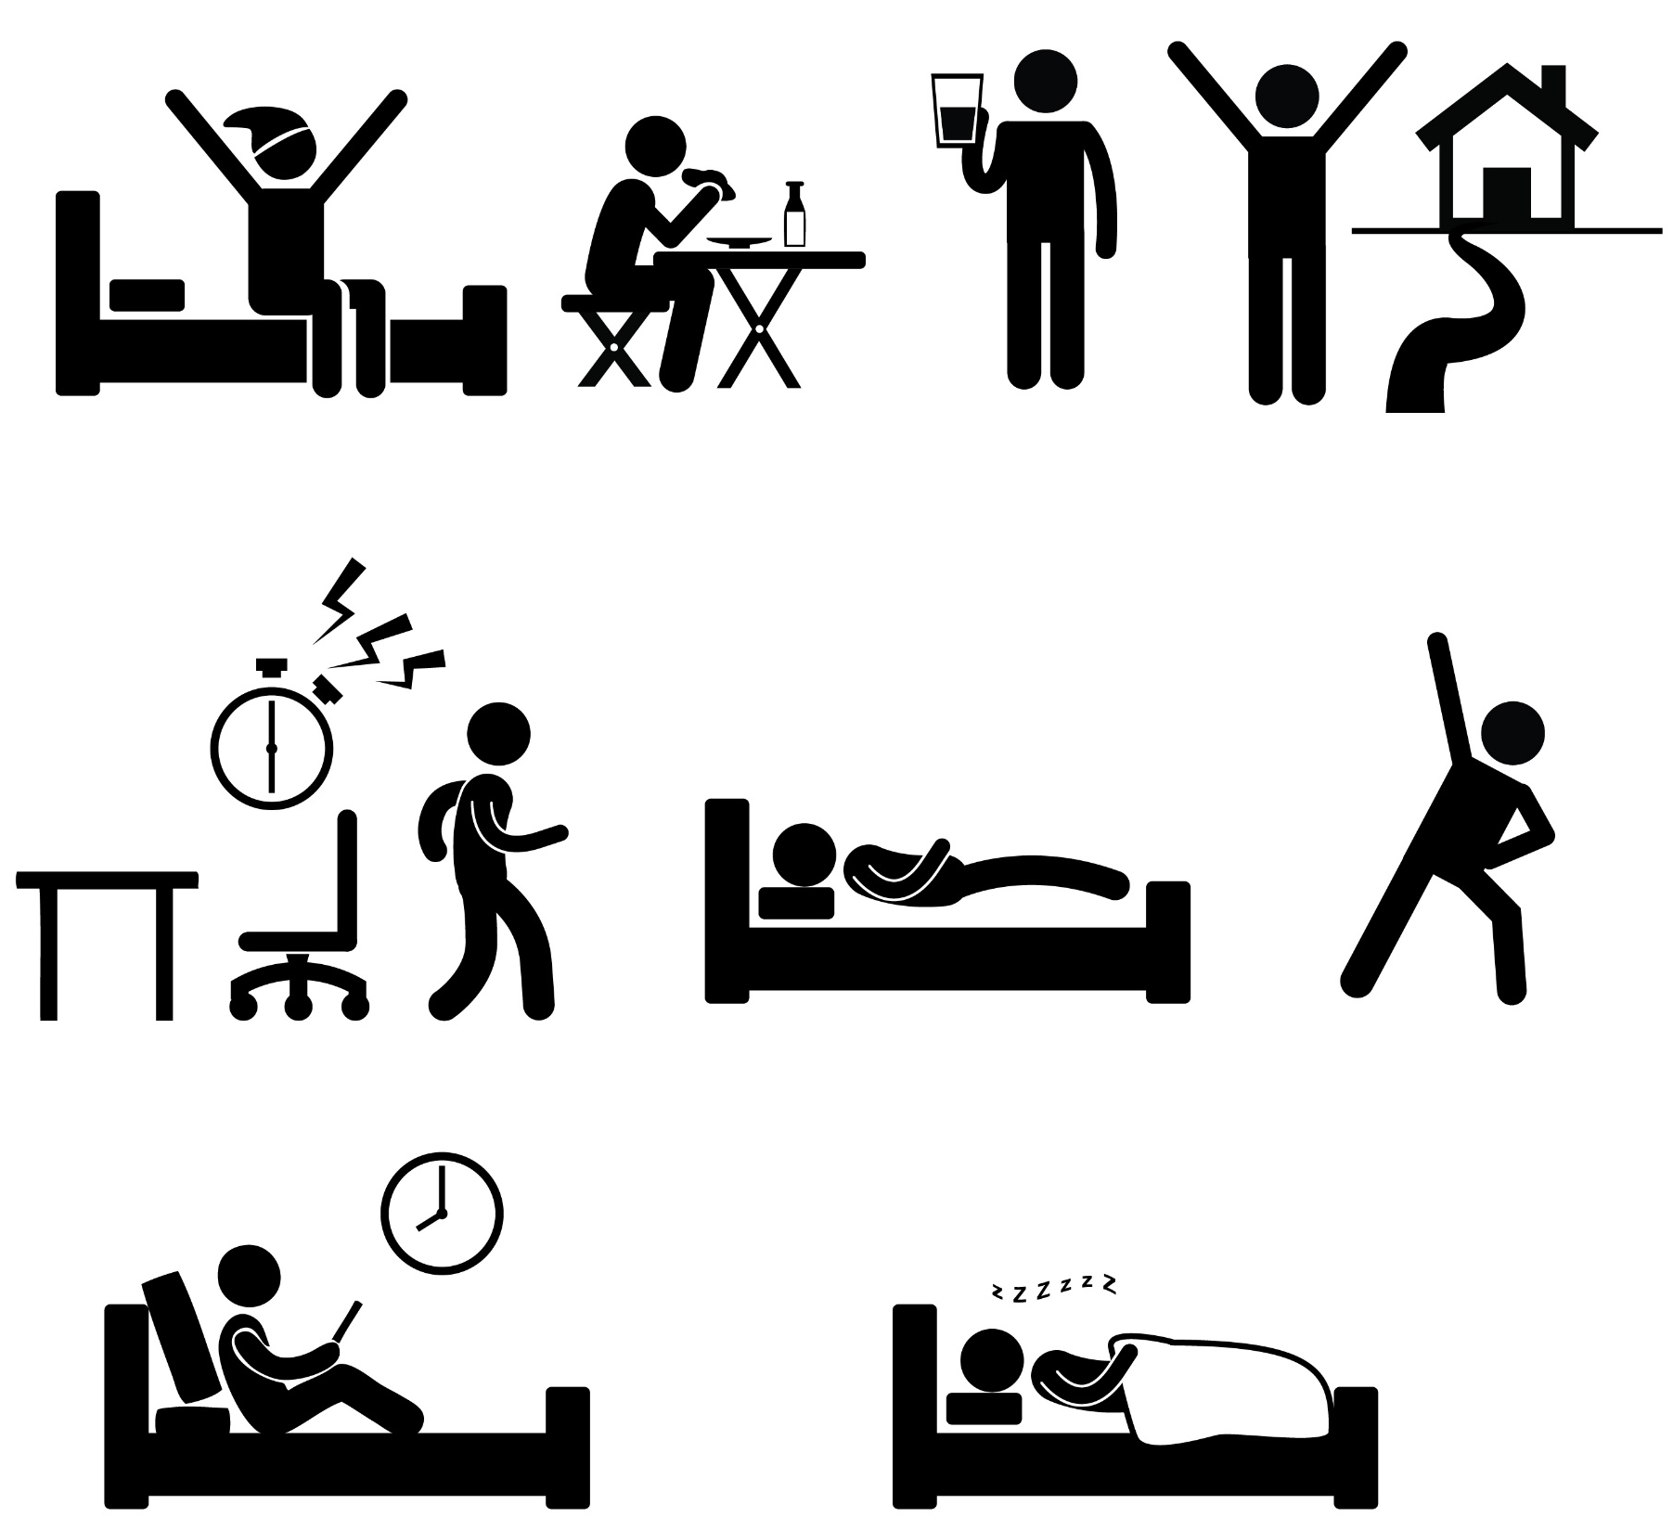
Daily
Activities

Slide 2
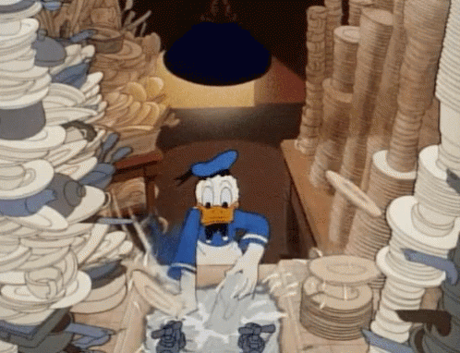
wash the dishes

Slide 3
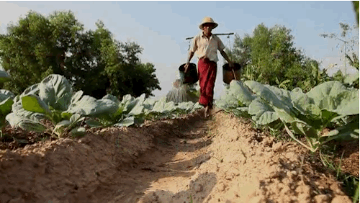
water the plants

Slide 4
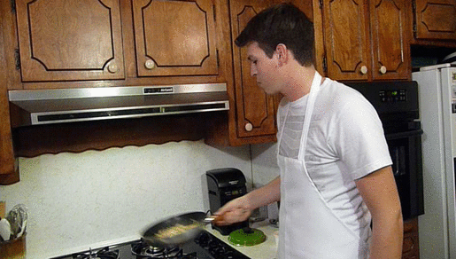
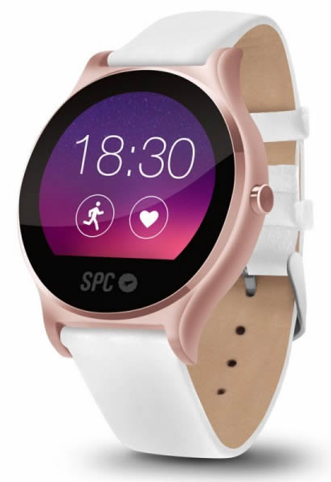
cook dinner

Slide 5
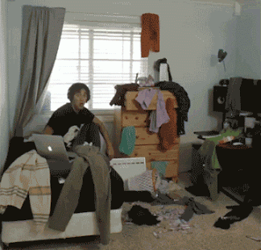
clean my room
your
his
her
our
their
Mandy’s

Slide 6
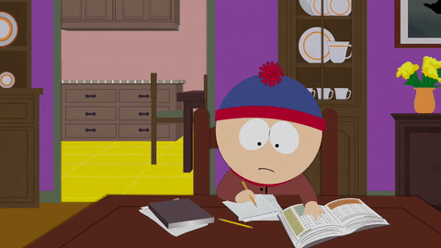
do his homework
my
your
her
our
their
Curry’s

Slide 7
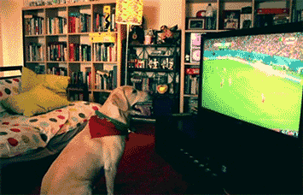
watch TV

Slide 8
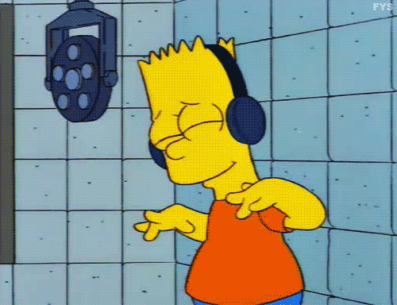
listen to music

Slide 9
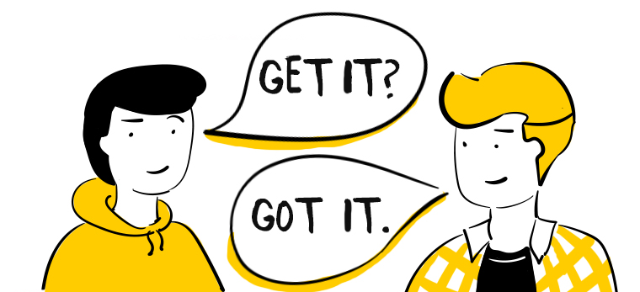
用時間來判斷
動詞作不同變化
現在式: every …
現在進行式: now
過去式: yesterday/ last …

Slide 10
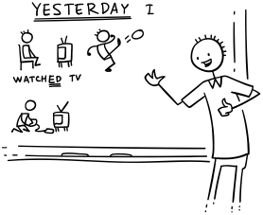
Focus on Past Tense!

Slide 11
washed the dishes
wash the dishes
〔t〕

Slide 12
watered the plants
water the plants
〔d〕

Slide 13
cooked dinner
cook dinner
〔t〕

Slide 14
clean my room
cleaned my room
your
his
her
our
their
Mandy’s
〔d〕

Slide 15
do his homework
did his homework
my
your
her
our
their
Curry’s

Slide 16
watched TV
watch TV
〔t〕

Slide 17
listened to music
listen to music
〔d〕

Slide 18
ed有三種發音
1.字的結尾發音喉嚨有震動→ 〔d〕
2.字的結尾發音喉嚨無震動→ 〔t〕
3.字的結尾是t或d→ 〔Id〕

Slide 19
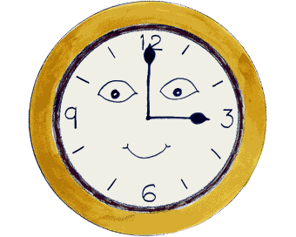
Let’s learn some past time!!

Slide 20
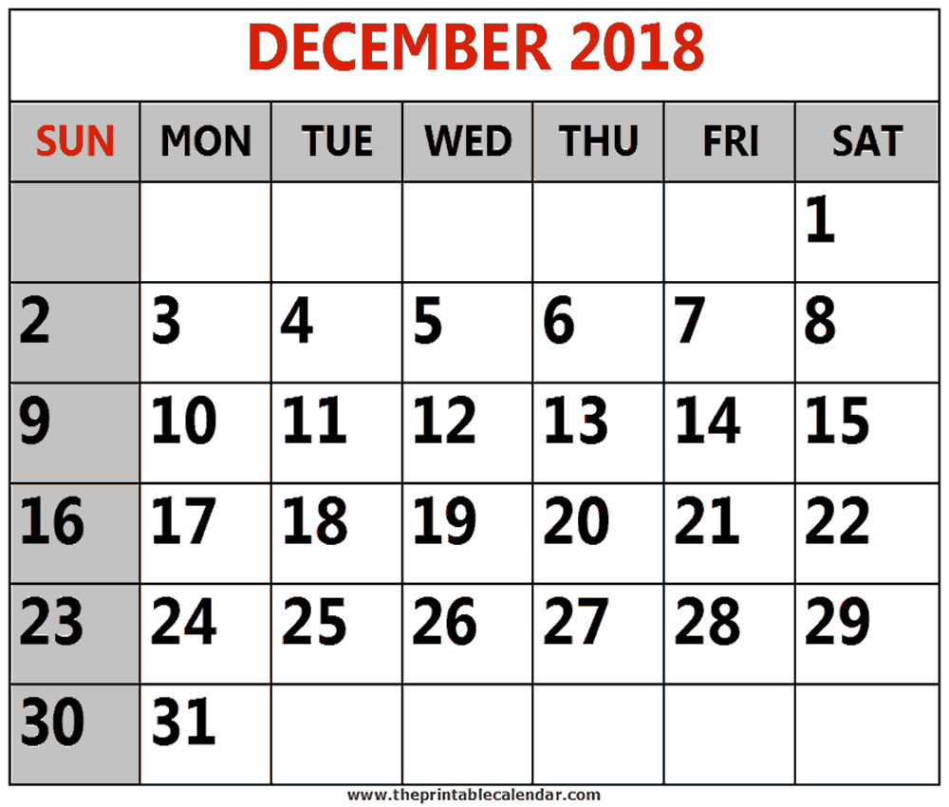
yesterday
today

Slide 21
last night
Dec
13th
Dec
14th

Slide 22
last Friday
today

Slide 23
last weekend
Saturday and Sunday,
or Friday evening until Sunday night.
today

Slide 24
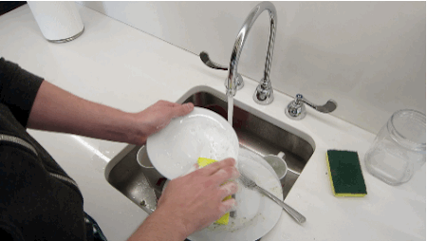
wash
the
I washed the dishes yesterday.
yesterday
dish
I

Slide 25
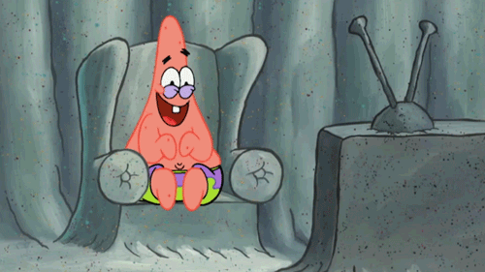
yesterday
TV
He watched TV yesterday morning.
he
morning
watch

Slide 26
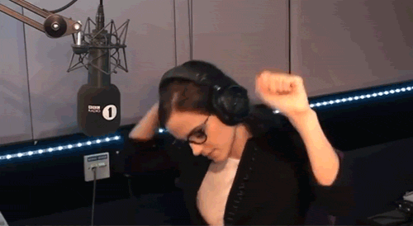
listen
last
She listened to music last night.
music
she
to
night

Slide 27
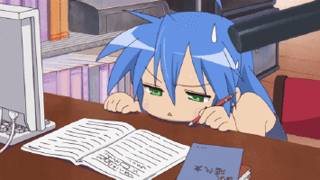
homework
did
He did his homework then.
then
his
he

Slide 28
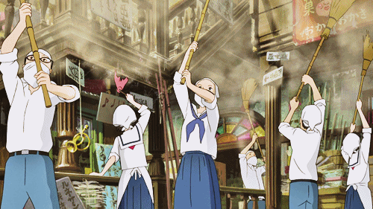
weekend
they
They cleaned their room last weekend.
last
room
clean
their

Slide 29
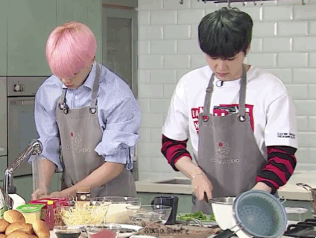
dinner
BTS
BTS cooked dinner yesterday afternoon.
afternoon
cook
yesterday

Slide 30
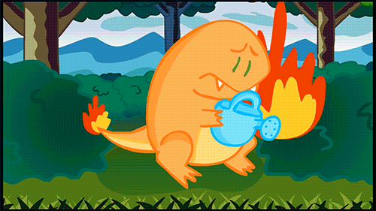
plant
Charmander
Charmander watered the plants last Sunday.
water
the
last
Sunday

Slide 32
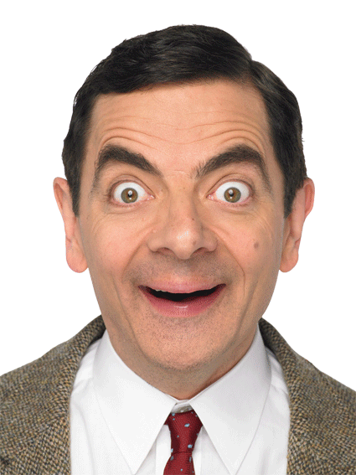
got up
made his bed
woke up
opened the curtains
did some exercise
shaved his heavy beard
saw a sign
opened the wardrobe
took out his clothes
covered teddy (with the blanket)
went to the dentist

Slide 33
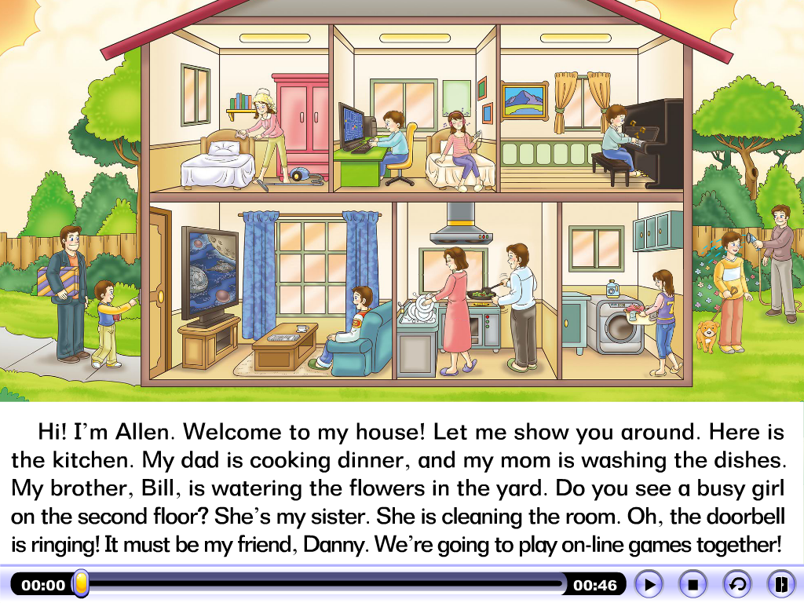

Slide 34
sister
brother Bill
Allen
Dad
friend
Danny
Mom

Slide 35
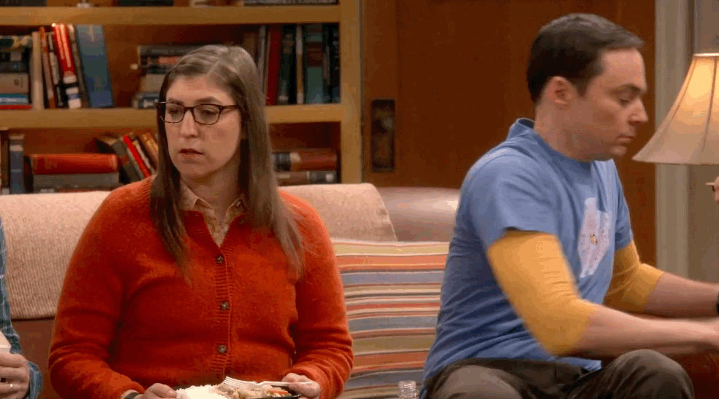

Slide 36
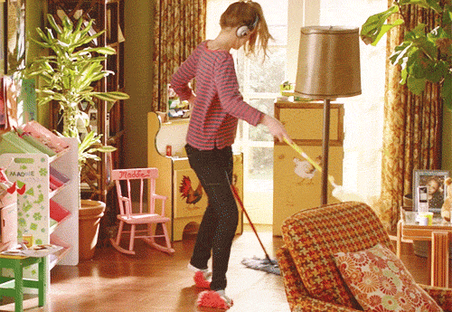
cleaned the room
clean the room
vacuum吸塵
〔d〕
sweep掃
mop拖

Slide 37
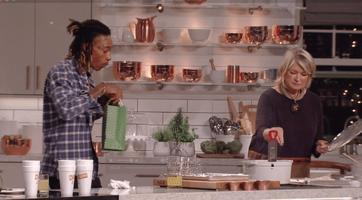
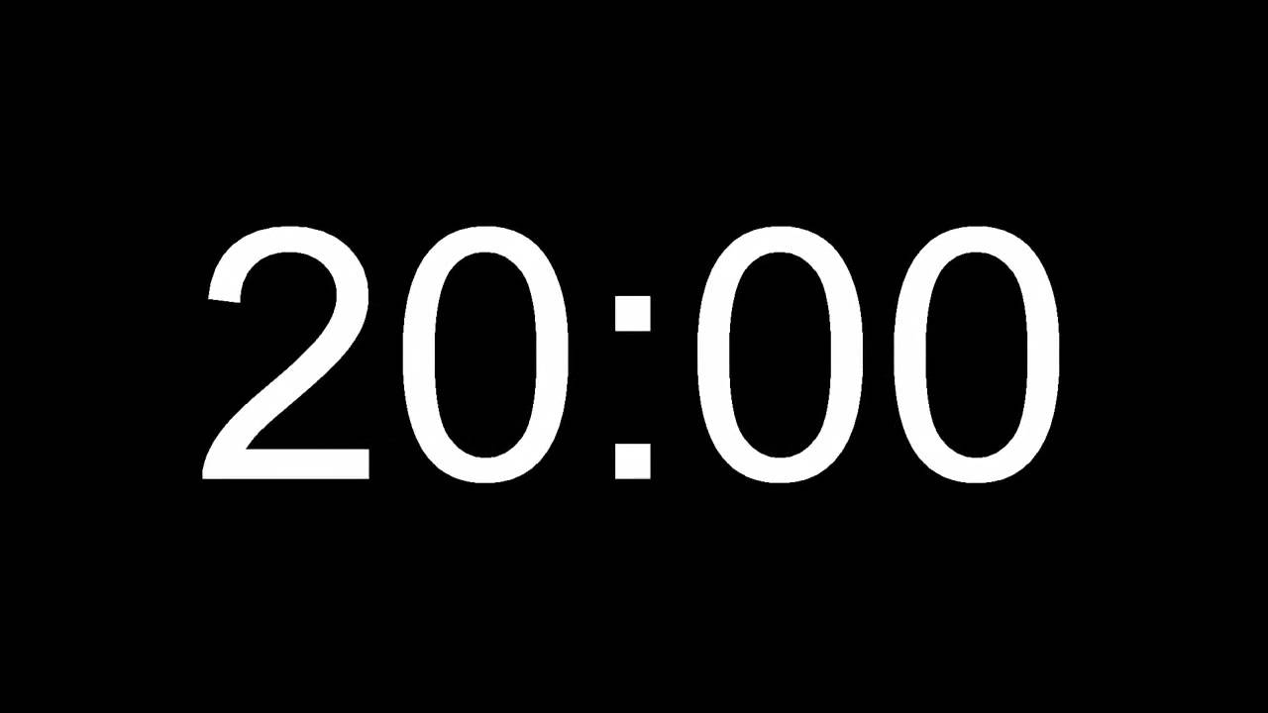
cooked dinner
cook dinner
〔t〕
宵夜
midnight snack late night meal

Slide 38
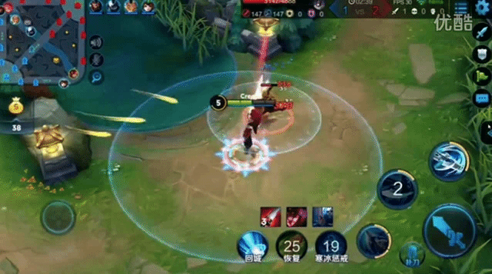
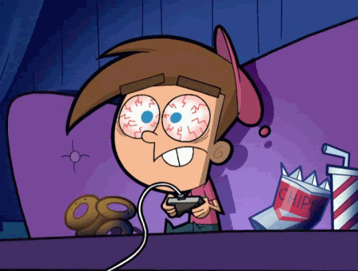
play on-line games
played on-line games
〔d〕

Slide 39
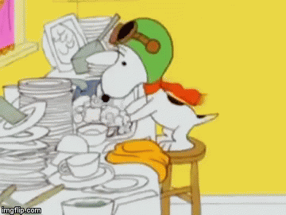
washed the dishes
wash the dishes
〔t〕
do the dishes

Slide 40
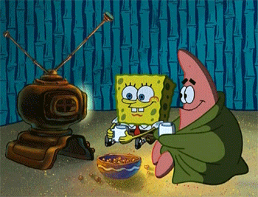
watch a movie
watched a movie
See a movie 是指在電影院看電影，而 watch a movie 則是在電視上、電腦上或其他可觀賞影片的裝置上看電影。
〔t〕

Slide 41
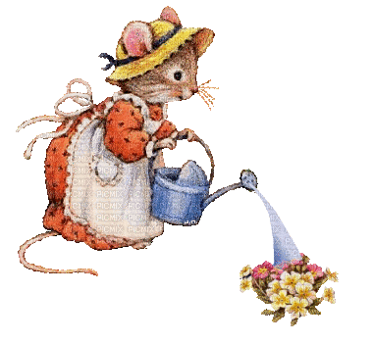
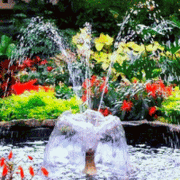
water the flowers
watered the flowers
〔d〕

Slide 42
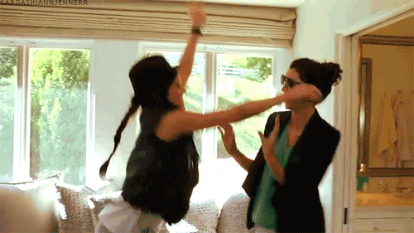
visit a friend
visited a friend
〔Id〕

Slide 43
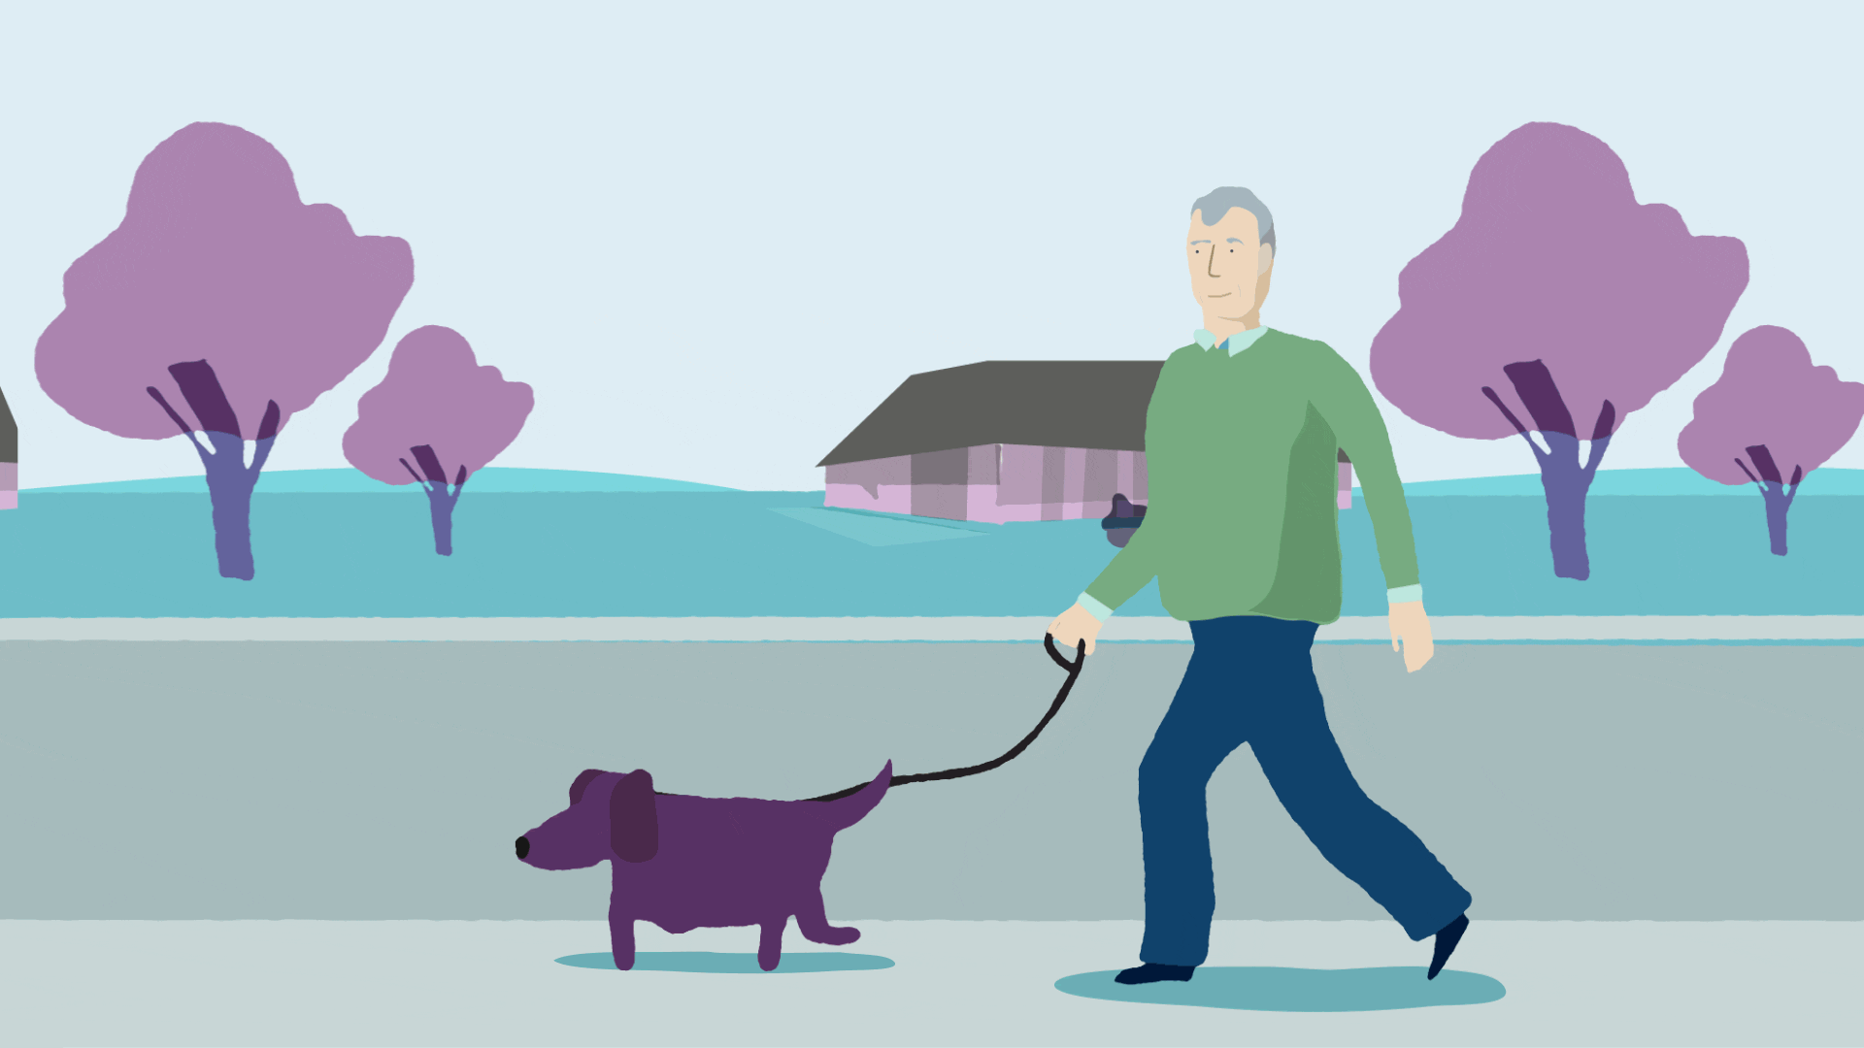
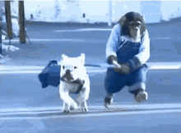
walked the dog
walk the dog
〔t〕

Slide 44
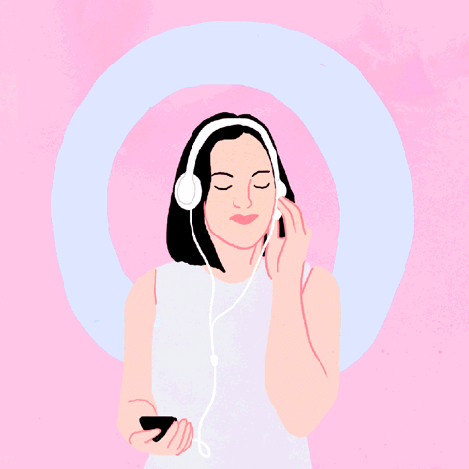
listened to music
listen to music
〔d〕

Slide 45
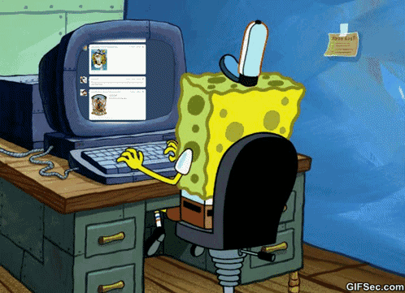
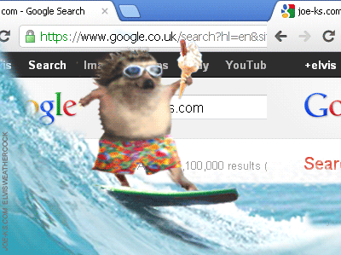
surfed the Internet
surf the Internet
〔t〕

Slide 46
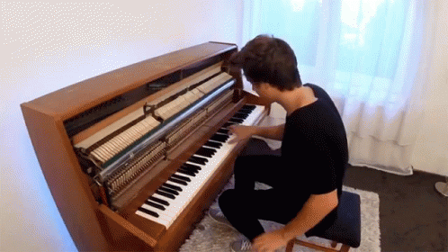
played the piano
play the piano
樂器前要加
the
〔d〕
play the flute吹笛
play the violin拉小提琴

Slide 47
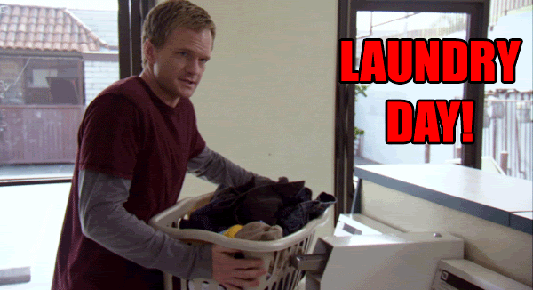
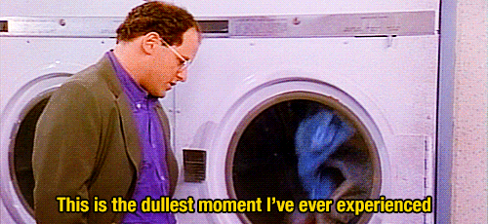
did the laundry
do the laundry

Slide 48
Let’s review all these 12 activities!

Slide 49
cleaned the room
clean the room
vacuum吸塵
〔d〕
sweep掃
mop拖

Slide 50
cooked dinner
cook dinner
〔t〕
宵夜
midnight snack late night meal

Slide 51
play on-line games
played on-line games
〔d〕

Slide 52
washed the dishes
wash the dishes
〔t〕
do the dishes

Slide 53
watch a movie
watched a movie
See a movie 是指在電影院看電影，而 watch a movie 則是在電視上、電腦上或其他可觀賞影片的裝置上看電影。
〔t〕

Slide 54
water the flowers
watered the flowers
〔d〕

Slide 55
visit a friend
visited a friend
〔Id〕

Slide 56
walked the dog
walk the dog
〔t〕

Slide 57
listened to music
listen to music
〔d〕

Slide 58
surfed the Internet
surf the Internet
〔t〕

Slide 59
played the piano
play the piano
〔d〕
樂器前要加
the
play the flute吹笛
play the violin拉小提琴

Slide 60
did the laundry
do the laundry

Slide 61
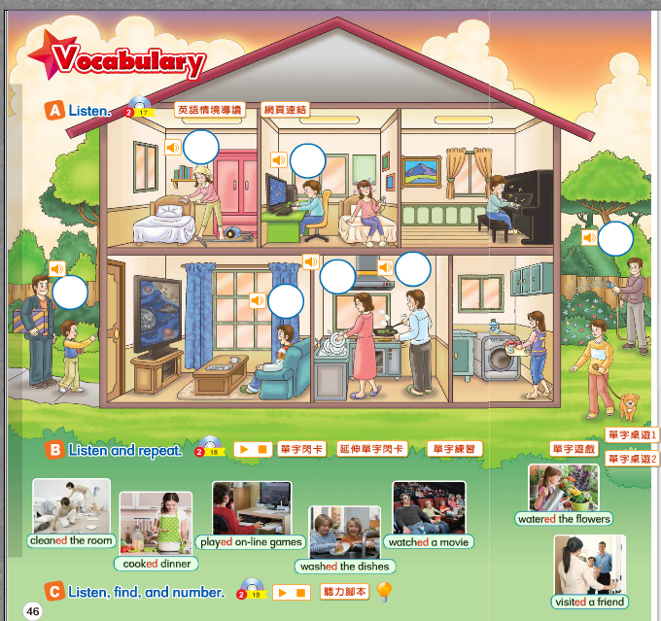

Slide 62
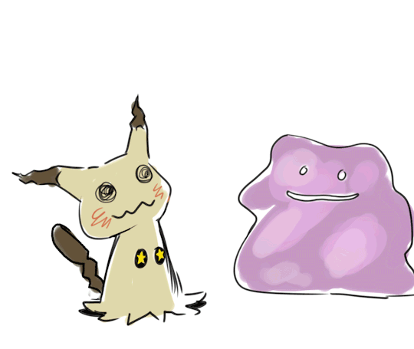
【本週英語作業】
1.聽:CD2 第22~24首。
2.寫:第四課12個過去式活動，每個5遍。

